Slide 1
CS4100: Computer Architecture Memory Hierarchy (II)
Prof. Chung-Ta King
Department of Computer Science
National Tsing Hua University, Taiwan

Slide 2
Outline
Introduction to memory hierarchy (Sec. 5.1)
Memory technologies (Sec. 5.2, 5.5)
Caches (Sec. 5.3, 5.4, 5.9)
Basic organization and design alternatives (Sec. 5.3)
Performance and design tradeoffs (Sec. 5.4)
Cache controller (Sec. 5.9)
Virtual memory (Sec. 5.7)
Framework for memory hierarchy (Sec. 5.8)
Virtual machines (Sec. 5.6)
Parallelism and memory hierarchies (Sec. 5.10, 5.11)

Slide 3
Cache Memory
Cache memory
The level of the memory hierarchy closest to the CPU
Give CPU an illusion of a very fast main memory
Target of instruction fetch, ld and sd
4 questions for cache design:
Q1: block placement
Q2: block identification
Q3: block replacement
Q4: write policy
CPU
Registers
Instr. operands
Cache (SRAM)
Blocks
Memory (DRAM)
Pages
Disk

Slide 4
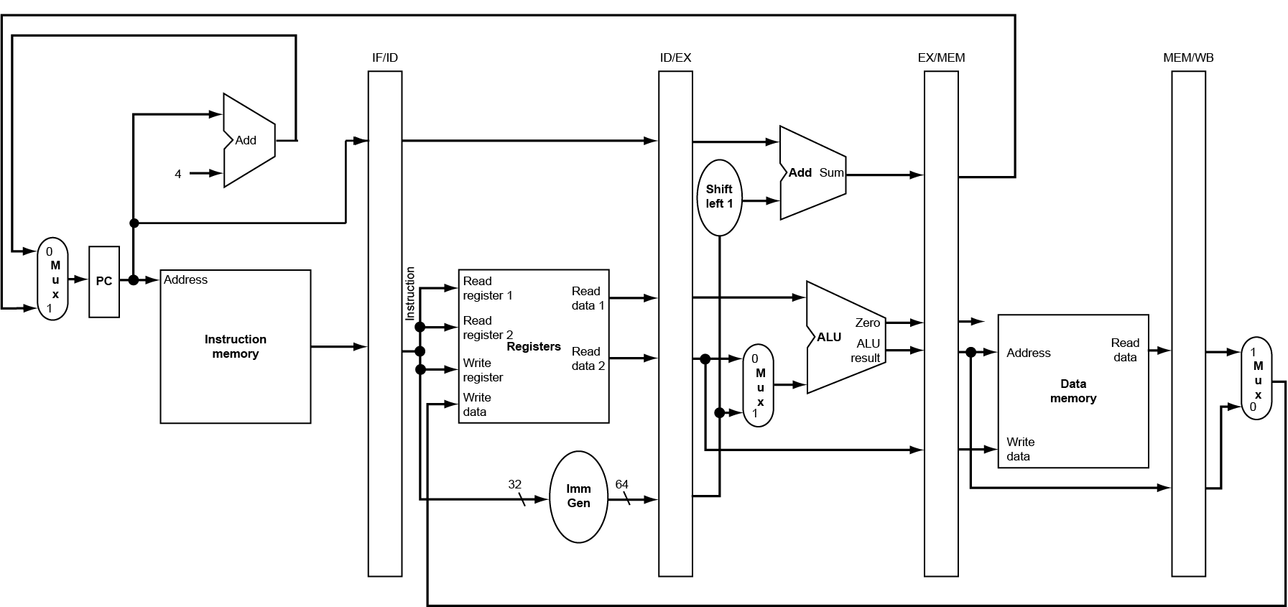
Cache and the CPU Pipeline
$
M
$
M

Slide 5
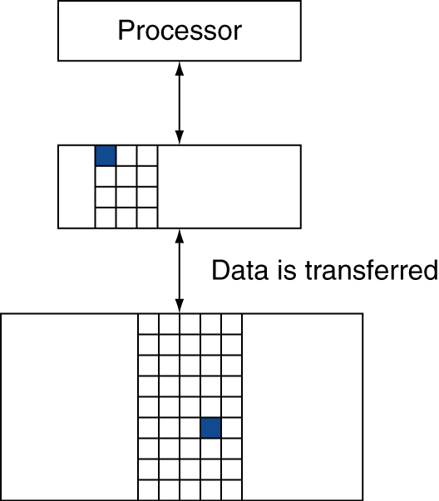
Q1: Block Placement
Where can a block be placed in upper level (cache)?
One fixed location: direct mapped
A few locations: set associative
Anywhere: fully associative
Location is determined by address of the block
Block placement determines how blocks are identified (Q2)
cache
memory

Slide 6
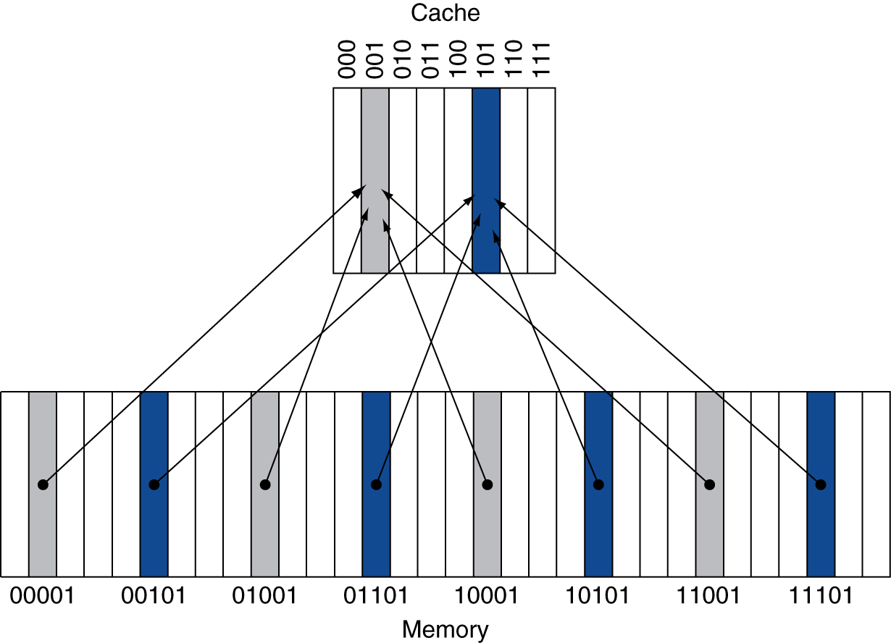
Direct Mapped Cache
Direct mapped: only one choice
For each block in main memory, there is only one location in cache where it can go
(Block address) modulo (#Blocks in cache), where #Blocks is a power of 2
Use low-order address bits
Fig. 5.8

Slide 7
Block Identification for Direct Mapped (Q2)
Since a block can be stored in only one location in cache, we only need to check that location to find the block → simple and fast
But, how do we know that location stores the right block, as multiple blocks may be stored there?
Store block address as well as the data
Actually only need the high-order bits, called the tag
What if there is no data in a location?
Use valid bit for each location in cache: 1 = present, 0 = not present (initial value)

Slide 8
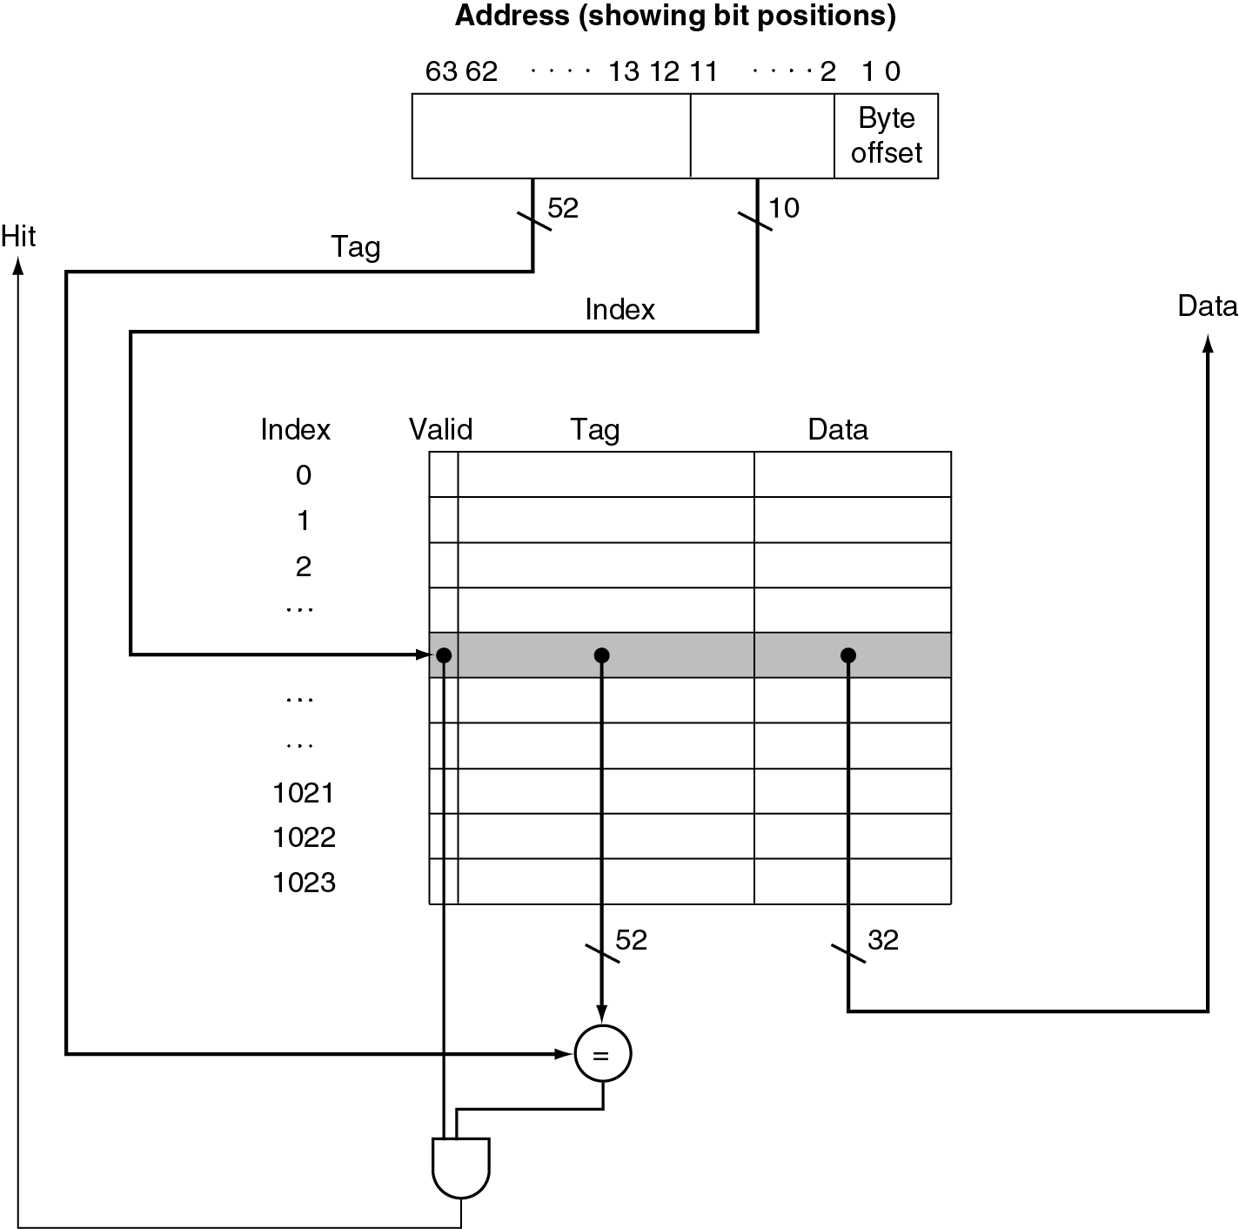
Organization of Direct Mapped Cache
1024 blocks, 1 word/block
Cache index: lower 10 bits
Cache tag: upper 52 bits
Valid bit (0 on start up)
Storage needed
(1+52+32)*1024
CPU
?
Fig. 5.10

Slide 9
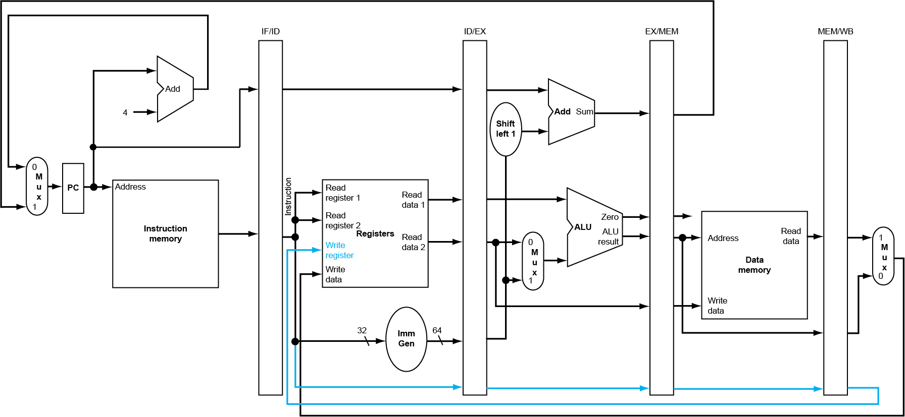
Recall EX Stage of ld
Addr

Slide 10
MEM Stage of ld
Addr
$
M

Slide 11
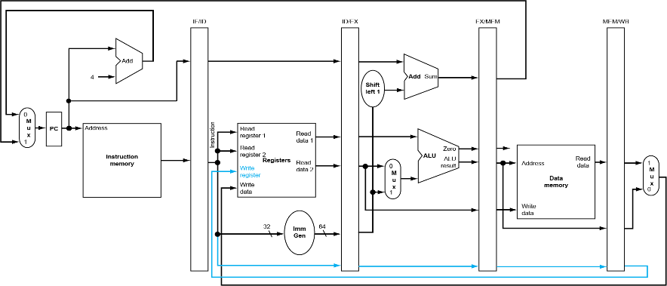
Direct-Mapped Cache
Cache controller
Index bits need not be stored and compared

Slide 12
Example of Direct Mapped Cache
8-blocks, 1 word/block, 10-bit address, direct mapped
Initial state of the cache:
Index | V | Tag | Data
000 | N
001 | N
010 | N
011 | N
100 | N
101 | N
110 | N
111 | N

Slide 13
Example of Direct Mapped Cache
Word addr | Binary addr | Cache block | Hit/miss
22 | 0001011000 | 110
From CPU
Miss
Index | V | Tag | Data
000 | N
001 | N
010 | N
011 | N
100 | N
101 | N
110 | N
111 | N
Y
00010
Mem[00 0101 1000]
Memory

Slide 14
Example of Direct Mapped Cache
Word addr | Binary addr | Cache block | Hit/miss
26 | 0001101000 | 010
From CPU
Miss
Index | V | Tag | Data
000 | N
001 | N
010 | N
011 | N
100 | N
101 | N
110 | N
111 | N
Y
00011
Mem[00 0110 1000]
Memory
Y
00010
Mem[00 0101 1000]

Slide 15
Example of Direct Mapped Cache
Word addr | Binary addr | Cache block | Hit/miss
22 | 0001011000 | 110
From CPU
Hit
Index | V | Tag | Data
000 | N
001 | N
010 | N
011 | N
100 | N
101 | N
110 | N
111 | N
Y
00011
Mem[00 0110 1000]
CPU
Y
00010
Mem[00 0101 1000]

Slide 16
Example of Direct Mapped Cache
Word addr | Binary addr | Cache block | Hit/miss
18 | 0001001000 | 010
From CPU
Miss
Replace
Index | V | Tag | Data
000 | Y | 00010 | Mem[00 0100 0000]
001 | N
010 | N
011 | Y | 00000 | Mem[00 0000 1100]
100 | N
101 | N
110 | N
111 | N
Y
00010
Y
00011
Mem[00 0110 1000]
Mem[00 0100 1000]
Memory
Y
00010
Mem[00 0101 1000]

Slide 17
Cache Misses
On cache hit (instruction fetch, ld, sd), CPU proceeds normally
On cache miss
Stall the CPU pipeline
Fetch block from main memory (DRAM)
Instruction cache miss: restart instruction fetch
Data cache miss: complete data access
The time to service a cache miss is called miss penalty
Problem with direct mapped: poor temporal locality
Many addresses may map to the same location in cache
The next time block A is accessed, its entry may be replaced by another block A’, even if other entries in cache are free

Slide 18
Other Block Placement Policies
Q1: Where can a block be placed in upper level (cache)?
One fixed location: direct mapped
A few locations: set associative
Anywhere: fully associative
cache
memory

Slide 19
Associative Caches
Fully associative:
Let a block to go in any cache entry → hard to be replaced
Replaced only when the cache is full
Cache identification: all entries are searched at once to find the block ➔ a comparator per entry (expensive)
n-way set associative: (a compromise)
Each set contains n entries and a given block can go to any entries in a set → fewer locations to place
Cache identification:
Block address determines which set: (Block number) modulo (#Sets in cache)
Search all entries in a given set at once ➔ n comparators (less expensive)

Slide 20
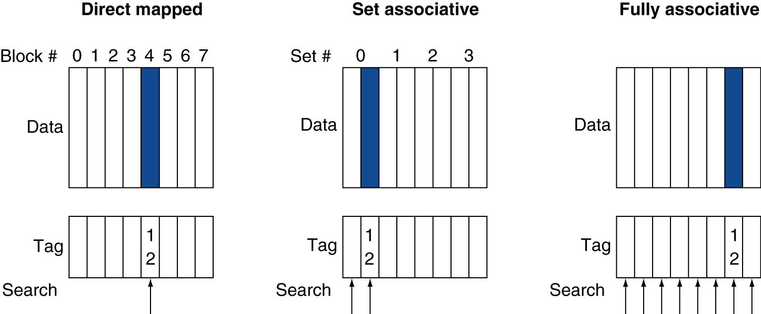
Associative Cache Example
Data R/W and tag search at the same time
Data R/W only after tag search & hit/miss decision
Fig. 5.14

Slide 21
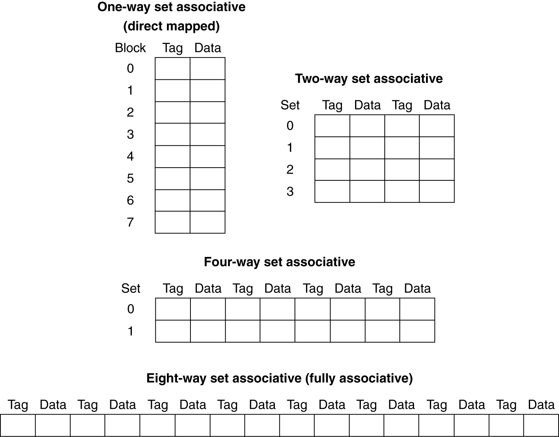
Spectrum of Associativity
For a cache with 8 entries
Fig. 5.15

Slide 22
Associativity Example
Compare 4-block caches
Direct mapped, 2-way set associative, fully associative
Block access sequence: 0, 8, 0, 6, 8
Direct mapped:
Block address | Cache index | Hit/miss | Cache content after access
 |  |  | Blk 0 | Blk 1 | Blk 2 | Blk 3
0 | 0 | miss | Mem[0]
8 | 0 | miss | Mem[8]
0 | 0 | miss | Mem[0]
6 | 2 | miss | Mem[0] |  | Mem[6]
8 | 0 | miss | Mem[8] |  | Mem[6]
Space not fully utilized

Slide 23
Associativity Example
2-way set associative:
Fully associative:
Block address | Cache index | Hit/miss | Cache content after access
 |  |  | Set 0 |  | Set 1
0 | 0 | miss | Mem[0]
8 | 0 | miss | Mem[0] | Mem[8]
0 | 0 | hit | Mem[0] | Mem[8]
6 | 0 | miss | Mem[0] | Mem[6]
8 | 0 | miss | Mem[8] | Mem[6]
Replacement matters
associativity ↑ ➔ miss rate ↓
Block address |  | Hit/miss | Cache content after access
0 |  | miss | Mem[0]
8 |  | miss | Mem[0] | Mem[8]
0 |  | hit | Mem[0] | Mem[8]
6 |  | miss | Mem[0] | Mem[8] | Mem[6]
8 |  | hit | Mem[0] | Mem[8] | Mem[6]

Slide 24
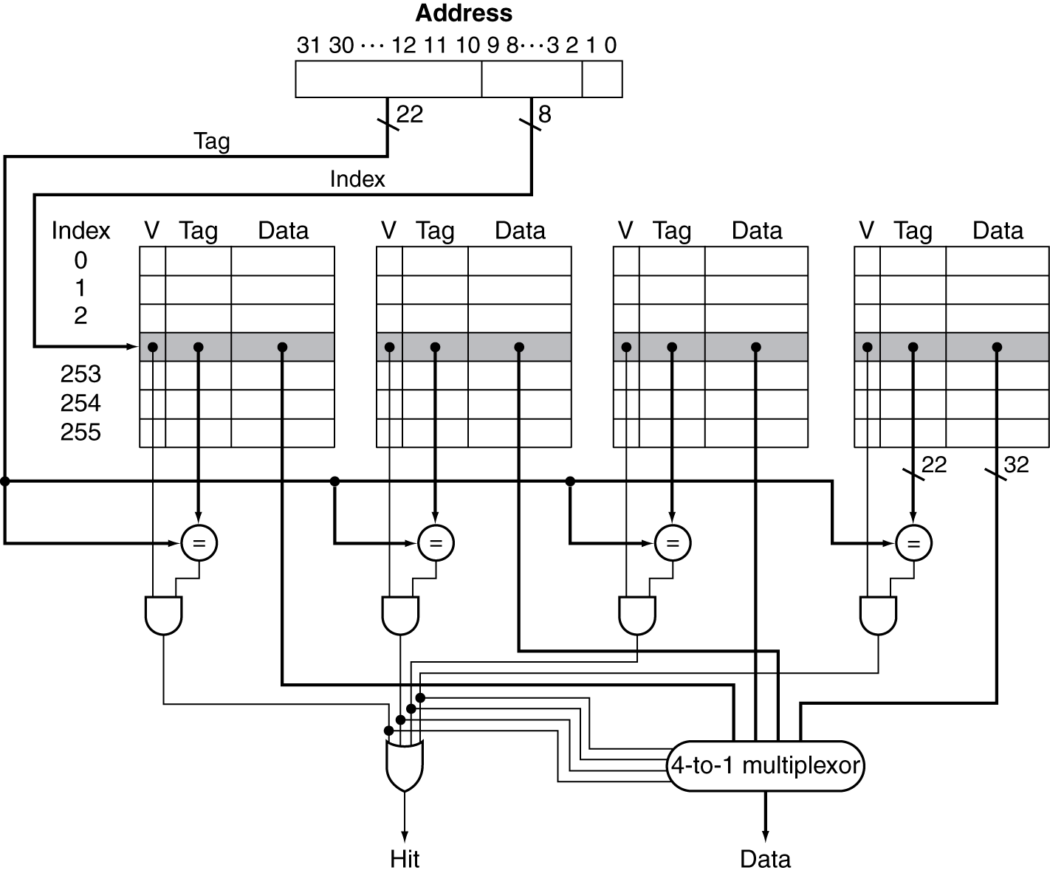
Set Associative Cache Organization
Increasing associativity shrinks index, expands tag
Fully associativity → no index field
54
4-way set associativity
4 comparators
Fig. 5.18

Slide 25
Q3: Block Replacement
Which block should be replaced on a miss?
Direct mapped: no choice
Set associative:
Prefer non-valid entry, if there is one
Otherwise, choose among entries in the set
Replacement policy: affect miss rate
Ideal: replace the block not to be used farthest in future
Least-recently used (LRU): use past history to predict future
Hardware chooses the one unused for the longest time
Simple for 2-way, too hard > 4-way → use approximation
Random:
Give similar performance as LRU for high associativity

Slide 26
An Approximate LRU
A “used bit” (initial 0) is associated with every block
When a block is accessed (hit or miss), its used bit is set to 1
On a replacement, a replacement pointer scans through the blocks to find a block with used bit = 0 to replace
Along the way, the replacement pointer also reset the encountered used bits from 1 to 0
Alternatively, if on an access, all other used bits in a set are 1, they are reset to 0 except the bit of the block that is accessed
Valid
Used
Tag
Replacement pointer
1
0
Blocks in a set
1
0
1
0
0

Slide 27
Q4: Write Policy
On write hit, could just update the block in cache
But then cache and memory would be inconsistent
Write through: also update memory
But makes write hits very long, e.g., if base CPI = 1, 10% of instructions are stores, write to memory takes 100 cycles
Effective CPI = 1 + 0.1×100 = 11
Solution: write buffer
Holds data waiting to be written to memory
CPU continues as if write is done, and stalls on write only if write buffer is full
Processor
Cache
Memory
Write Buffer

Slide 28
Write Policy
Alternative: Write back
On write hit, only update block in cache but not in memory
Faster write hits, less traffic to memory
But cache and memory are inconsistent
Need to track whether a block is dirty, by adding a dirty bit to each cache block
When a dirty block is to be replaced by a newly requested block, write it back to memory → longer read/write misses
Can use the write buffer to hold the write-back block while the newly requested block is read from memory. The write-back block is later written back to memory.

Slide 29
Write Policy
How to handle the write-missed block, which is in the memory?
For write through
Write allocate on miss: fetch the block into cache
So that later reads from the block will hit
No write allocate: don’t fetch the block into cache
Since programs often write a whole array before reading it, e.g., initialization
Also, writes usually end a series of computations
For write back
Usually fetch the block into cache (write allocate)

Slide 30
Example: Write Through with Allocate
Write hit: direct mapped
Memory
…
Index | V | Tag | Data
000 | Y | 00010 | A
001 | N
010 | Y | 00011 | B
011 | Y | 00000 | C
100 | N
101 | N
110 | Y | 00010 | D
111 | N
88
D
Write
buffer
CPU
sw E→M[72]
72
B
E
E
E
hit
64
A
…
12
C
8
Z
…
0

Slide 31
Example: Write Through with Allocate
Write miss: direct mapped
What happen on read miss, e.g., lw x2←M[72]?
Memory
…
Index | V | Tag | Data
000 | Y | 00010 | A
001 | N
010 | Y | 00011 | E
011 | Y | 00000 | C
100 | N
101 | N
110 | Y | 00010 | D
111 | N
88
D
Write
buffer
CPU
sw X→M[8]
72
E
00000
X
Z
X
miss
64
A
Z
…
12
C
8
Z
X
…
0

Slide 32
Example: Write Through with No-Allocate
Write miss under no write allocate
Memory
…
Index | V | Tag | Data
000 | Y | 00010 | A
001 | N
010 | Y | 00011 | E
011 | Y | 00000 | C
100 | N
101 | N
110 | Y | 00010 | D
111 | N
88
D
Write
buffer
CPU
sw X→M[8]
72
E
X
miss
64
A
…
12
C
8
X
Z
…
0

Slide 33
Example: Write Back
Write hit: direct mapped
Initially, cache contents consistent with memory
Memory
…
Index | V | D | Tag | Data
000 | Y | N | 00010 | A
001 | N
010 | Y | N | 00011 | B
011 | Y | N | 00000 | C
100 | N
101 | N
110 | Y | N | 00010 | D
111 | N
88
D
Write
buffer
CPU
sw E→M[72]
72
B
Y
E
hit
64
A
…
12
C
8
Z
…
0

Slide 34
Example: Write Back
Write miss: direct mapped
Normally with write allocate
What happen on read miss, e.g., lw x2←M[72]?
Memory
…
Index | V | D | Tag | Data
000 | Y | N | 00010 | A
001 | N
010 | Y | Y | 00011 | E
011 | Y | N | 00000 | C
100 | N
101 | N
110 | Y | N | 00010 | D
111 | N
88
D
Write
buffer
CPU
sw X→M[8]
72
B
00000
X
E
Z
E
miss
64
A
Z
…
12
C
8
Z
…
0

Slide 35
Summary: Comparing Cache Organizations
Direct mapped cache:
Simple and cheaper to implement:
Only one location to store a block in the cache → only one location to check (by simple indexing) and replace
Faster in detecting a cache hit and to replace:
Read data and tag at same time; compare only one tag
Poor temporal locality → higher miss rate
N-way set-associative cache:
A block has a choice of N locations → higher hit rate
More expensive: N comparators, larger tag field
Slower:
Extra MUX delay to select a block from the set
Data comes AFTER hit/miss decision and set selection

Slide 36
Outline
Introduction to memory hierarchy (Sec. 5.1)
Memory technologies (Sec. 5.2, 5.5)
Caches (Sec. 5.3, 5.4, 5.9)
Basic organization and design alternatives (Sec. 5.3)
Performance and design tradeoffs (Sec. 5.4)
Cache controller (Sec. 5.9)
Virtual memory (Sec. 5.7)
Framework for memory hierarchy (Sec. 5.8)
Virtual machines (Sec. 5.6)
Parallelism and memory hierarchies (Sec. 5.10, 5.11)

Slide 37
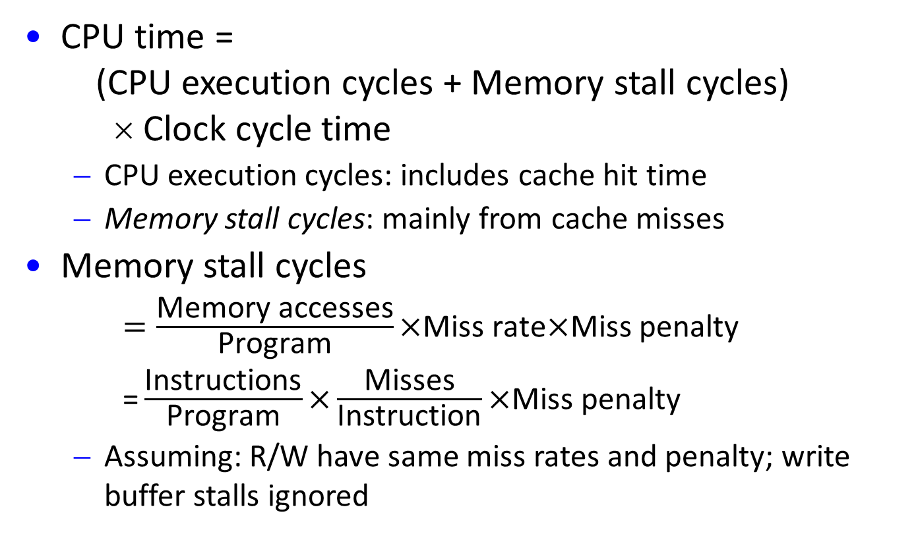
CPU Performance with Cache
CPU time = (CPU execution cycles + Memory stall cycles) × Clock cycle time
CPU execution cycles: includes cache hit time
Memory stall cycles: mainly from cache misses
Memory stall cycles
$=\frac{\text{Memory} \text{accesses}}{\text{Program}}\text{×}\text{Miss} \text{rate}\text{×}\text{Miss} \text{penalty}$
$\text{=}\frac{\text{Instructions}}{\text{Program}}\text{×}\frac{\text{Misses}}{\text{Instruction}}\text{×}\text{Miss} \text{penalty}$
Assuming: R/W have same miss rates and penalty; write buffer stalls ignored
Notes:
Read and write have same miss rate and miss penalty; I-cache and D-cache have same miss rate and miss penalty;
Write buffer stalls are negligible.

Slide 38
Cache Performance Example
Given
I-cache miss rate = 2%
D-cache miss rate = 4%
Miss penalty = 100 cycles
Base CPI (ideal cache) = 2
Load and stores are 36% of instructions
Miss cycles per instruction = misses/instr. × penalty
I-cache: 0.02 × 100 = 2 cycles/instruction
D-cache: 0.36 × 0.04 × 100 = 1.44 cycles/instruction
Actual CPI = 2 + 2 + 1.44 = 5.44 cycles/instruction
Ideal CPU is 5.44/2 =2.72 times faster

Slide 39
Average Memory Access Time
Hit time, though counted in CPU execution cycle, cannot be ignored in considering CPU performance
Tend to increase with more flexible and complex cache designs → may dominate the improvement in hit rate
Consider Average memory access time (AMAT)
AMAT = Hit time + Miss rate × Miss penalty
Example: AMAT per instruction
CPU with 1ns clock, hit time = 1 cycle, miss penalty = 20 cycles, miss rate = 0.05 misses per instruction
R/W miss penalties are the same; ignore other write stalls
AMAT/instruction = 1 + 0.05 × 20 = 2ns
2 cycles per instruction

Slide 40
Main Memory Supporting Caches
Use DRAMs for main memory
Fixed width (e.g., 1 word)
Connected by fixed-width clocked bus
Bus clock is typically slower than CPU clock
Example cache block read
1 bus cycle for address transfer
15 bus cycles per DRAM access
1 bus cycle per data transfer
To read a 4-word block with a 1-word-wide memory
Miss penalty = 1 + 4×15 + 4×1 = 65 bus cycles
Bandwidth = 16 bytes / 65 cycles = 0.25 B/cycle

Slide 41
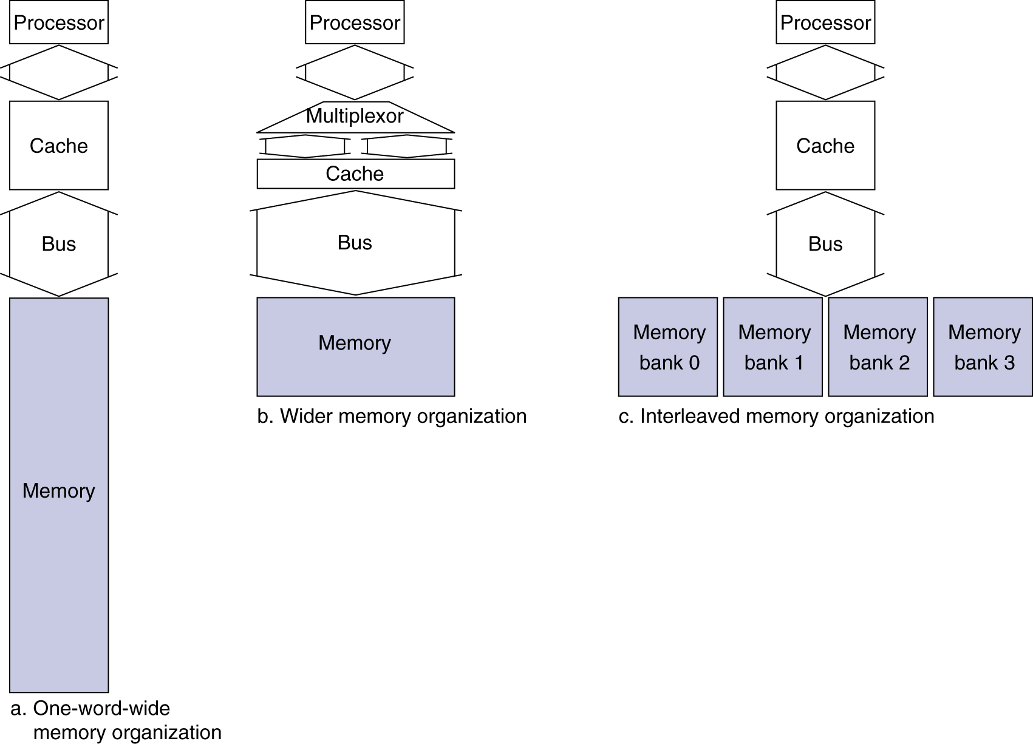
Main Memory Supporting Caches
4-word wide memory
Miss penalty = 1 + 15 + 1 = 17 bus cycles
Bandwidth = 16 bytes / 17 cycles = 0.94 B/cycle
4-bank interleaved memory
Miss penalty = 1 + 15 + 4×1 = 20 bus cycles
Bandwidth = 16 bytes / 20 cycles = 0.8 B/cycle

Slide 42
Implications of Cache Performance
When CPU performance is increased
Miss penalty becomes more significant
Decreasing base CPI
Greater proportion of time spent on memory stalls
Increasing clock rate
Memory stalls account for more CPU cycles
Can’t neglect cache behavior when evaluating system performance

Slide 43
Sources of Cache Misses
Compulsory (cold start) misses:
First access to a block, not much we can do
Solution: larger block size
Conflict (collision) misses:
>1 memory blocks mapped to same location
Solution 1: increase cache size
Solution 2: increase associativity
Capacity misses:
Cache cannot hold all blocks needed by program execution; a replaced block is later accessed again
Solution: increase cache size
Notes:
(Capacity miss) That is the cache misses are due to the fact that the cache is simply not large enough to contain all the blocks that are accessed by the program. The solution to reduce the Capacity miss rate is simple: increase the cache size.
Here is a summary of other types of cache miss we talked about.
First is the Compulsory misses. These are the misses that we cannot avoid. They are caused when we first start the program.
Then we talked about the conflict misses. They are the misses that caused by multiple memory locations being mapped to the same cache location.
There are two solutions to reduce conflict misses. The first one is, once again, increase the cache size. The second one is to increase the associativity.
For example, say using a 2-way set associative cache instead of directed mapped cache.
But keep in mind that cache miss rate is only one part of the equation. You also have to worry about cache access time and miss penalty. Do NOT optimize miss rate alone.
Finally, there is another source of cache miss we will not cover today. Those are referred to as invalidation misses caused by another process, such as IO , update the main memory so you have to flush the cache to avoid inconsistency between memory and cache.
+2 = 43 min. (Y:23)

Slide 44
Cache Design Space
Many interacting dimensions
Cache size
Block size
Associativity
Replacement policy
Write-through vs write-back
Write allocation
The optimal choice is a compromise
Depends on access characteristics
Workload, use (I-cache, D-cache)
Depends on technology and cost
Simplicity often wins
Cache Size
Associativity
Block Size
Bad
Good
Factor A
Factor B
Less
More

Slide 45
Design Tradeoff: Increase Block Size
Instead of 1024 blocks and 4 bytes/block, can organize the cache as 256 blocks and 16 bytes/block
To what block number does address 4500 map?
Block address = ⎣4500/16⎦ = 281
4500=00…001000110010100₂ /10000₂ → 00…00100011001₂
Block number = 281 modulo 256 = 25 = 00011001₂
63
12
11
4
3
0
Tag
Index
Offset
52 bits
8 bits
4 bits

Slide 46
Block Size Considerations
Larger blocks should reduce miss rate (compulsory misses) due to spatial locality
But in a fixed-sized cache
Larger blocks ⇒ fewer of them More competition ⇒ increased miss rate (capacity misses)
Larger blocks have larger miss penalty
Can offset benefit of reduced miss rate
Early restart and critical-word-first can help
Miss Penalty
Miss Rate
Exploits spatial locality
Ave. Access Time
Fewer blocks:
compromises
temporal locality
Increased miss penalty
and miss rate
Block Size
Block Size
Block Size

Slide 47
Design Tradeoff: How Much Associativity
Increasing associativity decreases miss rate (conflict misses)
But with diminishing returns
Also increases cost (e.g., more comparators) and hit time
Simulation of a system with 64KB D-cache, 16-word blocks, SPEC2000
1-way: 10.3%
2-way: 8.6%
4-way: 8.3%
8-way: 8.1%

Slide 48
Optimization: Multilevel Caches
Why multilevel cache?
Primary cache (Level-1) attached to CPU
Small, but fast
Level-2 cache services misses from primary cache
Larger, slower, but still faster than main memory
Reduce miss penalty
Main memory services L-2 cache misses
Some high-end systems include L-3 cache

Slide 49
Multilevel Cache Example
Given
CPU base CPI = 1, clock rate = 4GHz → cycle time = 0.25ns
Miss rate/instruction = 2%, Memory access time = 100ns
With just primary (L-1) cache
Miss penalty = 100ns/0.25ns = 400 cycles
Effective CPI = 1 + 0.02 × 400 = 9 cycles/instruction
Now add L-2 cache
Access time = 5ns, miss rate to main memory = 0.5%
L-1 cache miss penalty with L-2 hit = 5ns/0.25ns = 20 cycles
L-1 cache miss penalty with L-2 miss = 400 cycles
CPI = 1 + 0.02 × 20 + 0.005 × 400 = 3.4 cycles/instruction
Performance ratio = 9/3.4 = 2.6

Slide 50
Multilevel Cache Considerations
Primary cache
Focus on minimal hit time to give a shorter clock cycle or fewer pipeline stages
L-2 cache
Focus on low miss rate to avoid main memory access
Hit time has less overall impact
Results
L-1 cache usually smaller than a single-level cache, with a block size smaller than in L-2 to match smaller cache and reduce miss penalty
L2 cache much larger than 1-level cache (for access time less critical); larger block size, higher associativity than L-1

Slide 51
Cache Design Trade-offs
Design Change | Effect on Miss Rate | Negative Performance Effect
Increase cache size | Decrease capacity misses | May increase access time
Increase associativity | Decrease conflict misses | May increase access time
Increase block size | Decrease compulsory misses | Increases miss penalty and for very large block size, may increase miss rate due to pollution
Fig. 5.37

Slide 52
Example: Intrinsity FastMATH
Embedded MIPS processor
12-stage pipeline
May have instruction and data accesses on each cycle
Split cache: separate I-cache and D-cache
Each 16KB: 256 blocks × 16 words/block
Direct mapped
D-cache: write-through or write-back decided by OS
One-entry write buffer
SPEC2000 miss rates
I-cache: 0.4%
D-cache: 11.4%
Weighted average: 3.2%

Slide 53
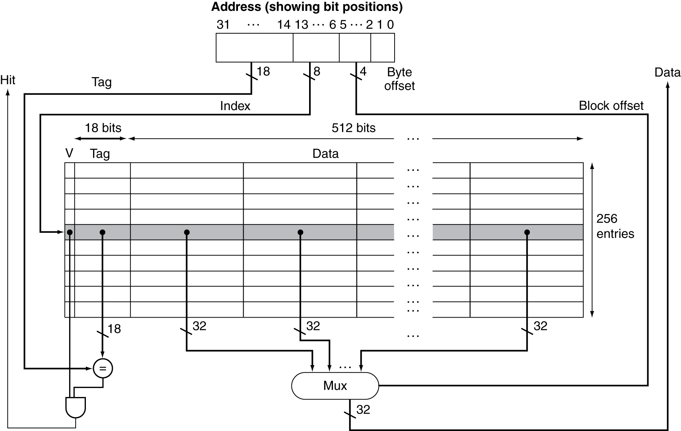
Example: Intrinsity FastMATH
Fig. 5.12

Slide 54
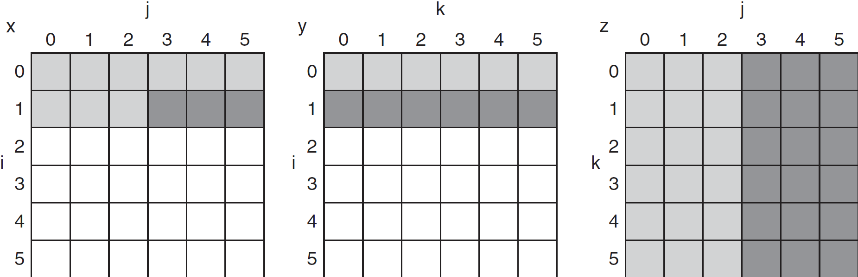
Software Optimization via Blocking
Goal: maximize accesses to data before it is replaced
Consider inner loops of DGEMM:
for (int j = 0; j < n; ++j) {
double cij = C[i+j*n];
for(int k = 0; k < n; k++)
cij += A[i+k*n] * B[k+j*n];
C[i+j*n] = cij;
}
Cache misses if k is large
C
A
B
Fig. 5.20

Slide 55
Cache Blocked DGEMM
void do_block (int n, int si, int sj, int sk, double *A,
double *B, double *C) {
for (int i = si; i < si+BLOCKSIZE; ++i)
for (int j = sj; j < sj+BLOCKSIZE; ++j) {
double cij = C[i+j*n]; /* cij = C[i][j] */
for( int k = sk; k < sk+BLOCKSIZE; k++ )
cij += A[i+k*n] * B[k+j*n]; /* cij+=A[i][k]*B[k][j] */
C[i+j*n] = cij; /* C[i][j] = cij */
}
}
void dgemm (int n, double* A, double* B, double* C) {
for ( int sj = 0; sj < n; sj += BLOCKSIZE )
for ( int si = 0; si < n; si += BLOCKSIZE )
for ( int sk = 0; sk < n; sk += BLOCKSIZE )
do_block(n, si, sj, sk, A, B, C);
}

Slide 56
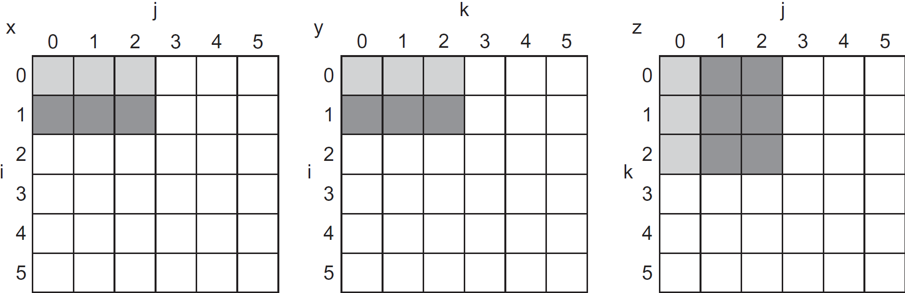
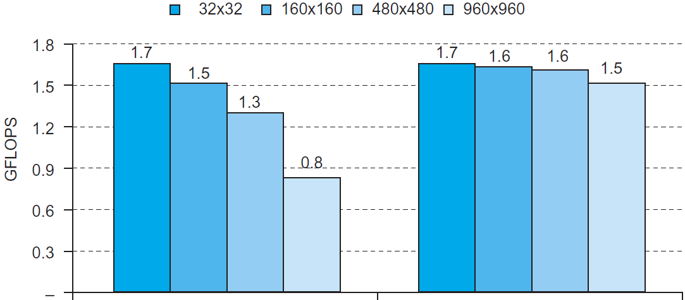
Blocked DGEMM Access Pattern
C
A
B
Fig. 5.22
Fit into cache
Unoptimized
Blocked

Slide 57
Outline
Introduction to memory hierarchy (Sec. 5.1)
Memory technologies (Sec. 5.2, 5.5)
Caches (Sec. 5.3, 5.4, 5.9)
Basic organization and design alternatives (Sec. 5.3)
Performance and design tradeoffs (Sec. 5.4)
Cache controller (Sec. 5.9)
Virtual memory (Sec. 5.7)
Framework for memory hierarchy (Sec. 5.8)
Virtual machines (Sec. 5.6)
Parallelism and memory hierarchies (Sec. 5.10, 5.11)

Slide 58
Cache Control
Example cache characteristics
Direct-mapped, write-back, write allocate
Block size: 4 words (16 bytes)
Cache size: 16 KB (1024 blocks)
32-bit byte addresses
Valid bit and dirty bit per block
Blocking cache: CPU waits until access is complete
31
10
9
4
3
0
Tag
Index
Offset
18 bits
10 bits
4 bits

Slide 59
Interface Signals
CPU
Cache
Memory
Read/Write
Read/Write
Enable
Enable
Address
32
Address
32
Write Data
32
Write Data
128
Read Data
32
Read Data
128
Ready
Ready
Multiple cycles per access
Notes:
The signals between the processor to the cache are
■ 1-bit Read or Write signal
■ 1-bit Valid signal, saying whether there is a cache operation or not
■ 32-bit address
■ 32-bit data from processor to cache
■ 32-bit data from cache to processor
■ 1-bit Ready signal, saying the cache operation is complete

Slide 60
FSM of Cache Controller
Idle
Compare tag:
If Valid & Tag match (hit):
Write → write word; set Valid, Dirty, Tag; send Ready to CPU
Read → send word, Ready to CPU
Mark cache ready
From CPU: Enable, Read/Write,
Address, Write Data
Fig. 5.39
Miss and old block Dirty=1
Miss and old block Dirty=0
From Memory: Ready, Read Data
Allocate:
Send Enable, Read, Address to memory (to read new block)
Write-Back:
Send Enable, Write, Address, Write Data (old block) to memory
From memory:
Ready=1
From memory: Read=0

Slide 61
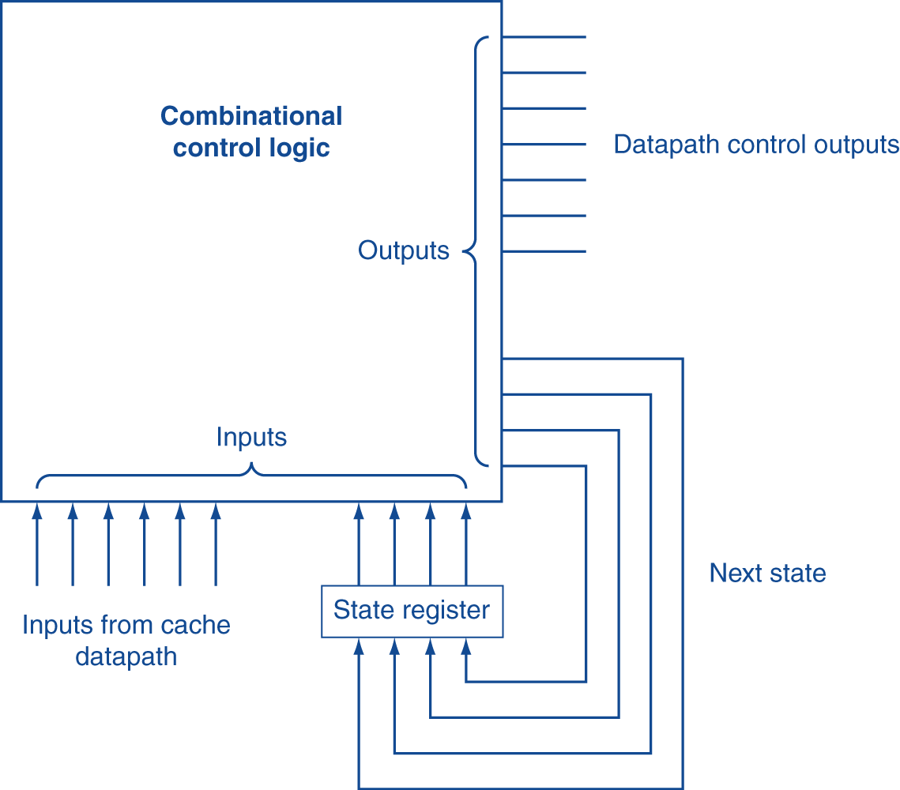
Finite State Machines
Use an FSM to sequence control steps
Set of states, transition on each clock edge
State values are binary encoded
Current state stored in the state register
Next state = f_{n} (current state, current inputs)
Control output signals = f_{o} (current state)
Fig. 5.38

Slide 62
Cache Summary
Principle of locality:
Program likely to access a small portion of address space
Temporal locality: locality in time
Spatial locality: locality in space
Three major categories of cache misses:
Compulsory: e.g., cold start misses.
Conflict: increase cache size or associativity
Capacity: increase cache size
Cache design space
Total size, block size, associativity
Policies: replacement, write-hit (write-through, write-back), write-miss (write allocate)
Notes:
Memory hierarchy works because of the Principle of Locality which says a program will access a relatively small portion of the address space at any instant of time.
There are two types of locality: temporal locality, or locality in time and spatial locality, or locality in space.
So far, we have covered three major categories of cache misses.
Compulsory misses are cache misses due to cold start. You cannot avoid them but if you are going to run billions of instructions anyway, compulsory misses usually don bother you.
Conflict misses are misses caused by multiple memory location being mapped to the same cache location.
The nightmare scenario is the ping pong effect when a block is read into the cache but before we have a chance to use it, it was immediately forced out by another conflict miss.
You can reduce Conflict misses by either increase the cache size or increase the associativity, or both.
Finally, Capacity misses occurs when the cache is not big enough to contains all the cache blocks required by the program. You can reduce this miss rate by making the cache larger.
There are two write policy as far as cache write is concerned. Write through requires a write buffer and a nightmare scenario is when the store occurs so frequent that you saturates your write buffer.
The second write polity is write back. In this case, you only write to the cache and only when the cache block is being replaced do you write the cache block back to memory.
+3 = 77 min. (Y:57)

